Slide 1
Empty Grid
Couple of additional points:
The blocks in your list Yash, that you shared on the call, that have IDs using letter/number/letter are that way because they were dissected out of the lung at one of our collaborators’ site and did not use the “millitomish”. Approach. We’ll need to put those in the RUI by hand.
As to the number of layers/slices for each dimension, Peter,
Y = slices = numerical = average 22, range 16-25
Z = strips made from slices = alphabetic= average = 4, range 1-6
X = numerical = average = 5, range 3-8
Not sure I have the X,Y, Z consistent with your naming, can switch as needed
Would it be better to build the model with the average or the maximum of the range? I’m thinking the latter but not sure. Then that would be
Y=25
Z=6
X=8
Better yet if we had the ability to choose the numbers to “morph the model” when aligning a block to a gridded model.
See you Monday, thanks so much
Gloria
I think Maximum or even Max*1.5ish would be best. It is also possible to do multiple sizes SM, Med, Large? It's a bit more work, but once the code is in place, it _should_ be a matter of changing configurations to generate multiple millitomes.
Thanks, Bruce
1
2
3
4
5
6
7
8
9
10
11
12
13
14
15
16
17
18
19
20
21
22
23
24
25
26
27
28
29

Slide 2
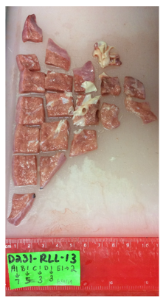
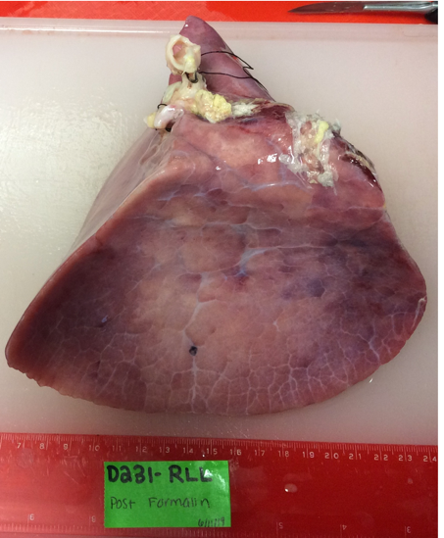
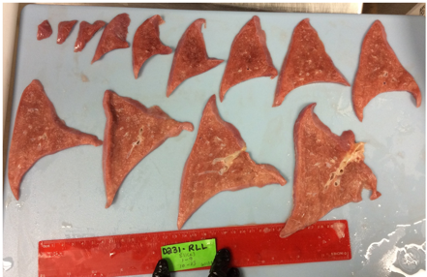
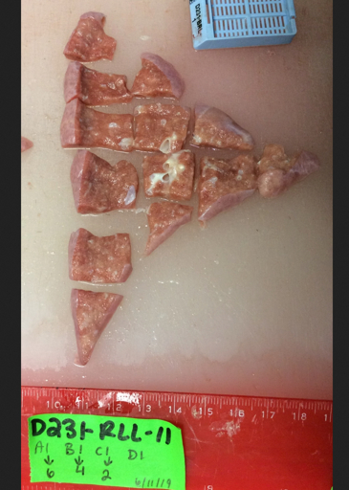
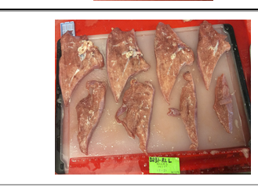
HBM725.CTFN.564 | D231-RLL-13B4 | TRUE | FALSE
One plane / slice
Y-> Equals first of three numbers
24
25
26
27
28
29
1
2
3
4
5
6
7
8
9
10
11
12
13
14
15
16
17
18
19
20
21
22
23
1 2. 3. 4. 5. 6. 7
Blocks Top to Bottom
A. B. C. D. E
Strips left to right
D231-RLL
D231-RLL-13A2
Slice 13, Strip A, Block 2

Slide 3
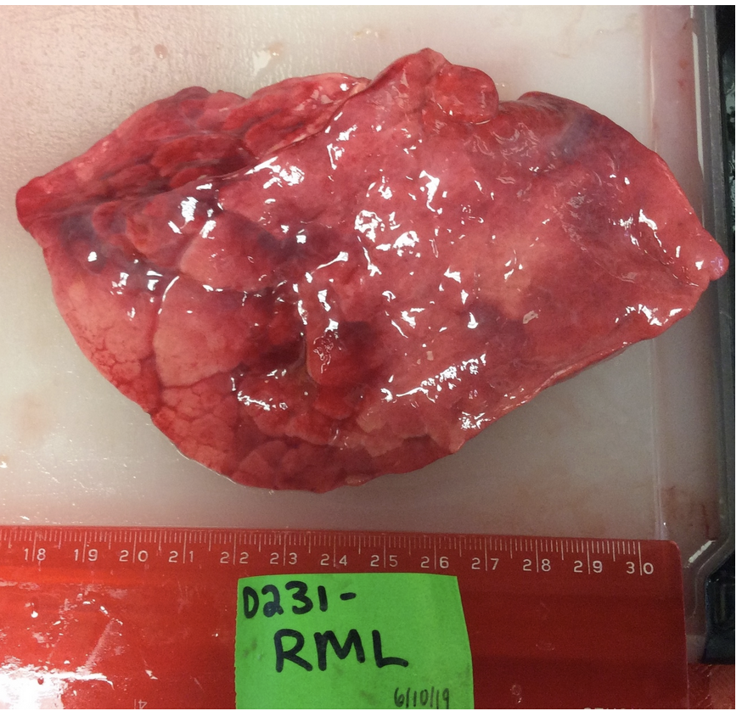
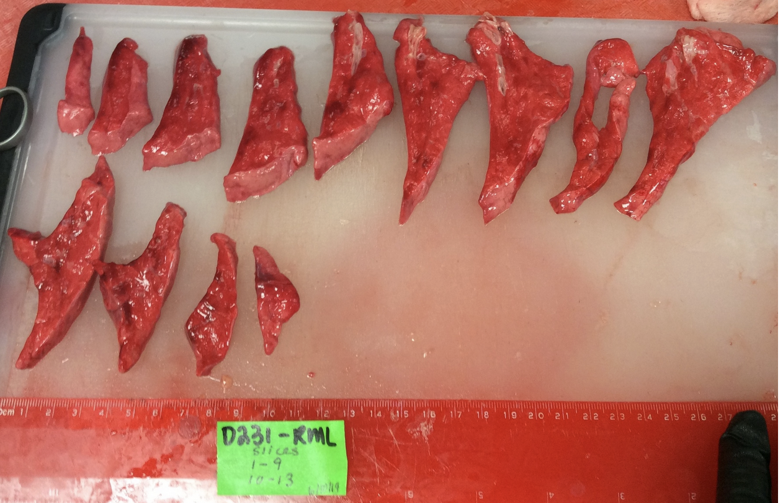
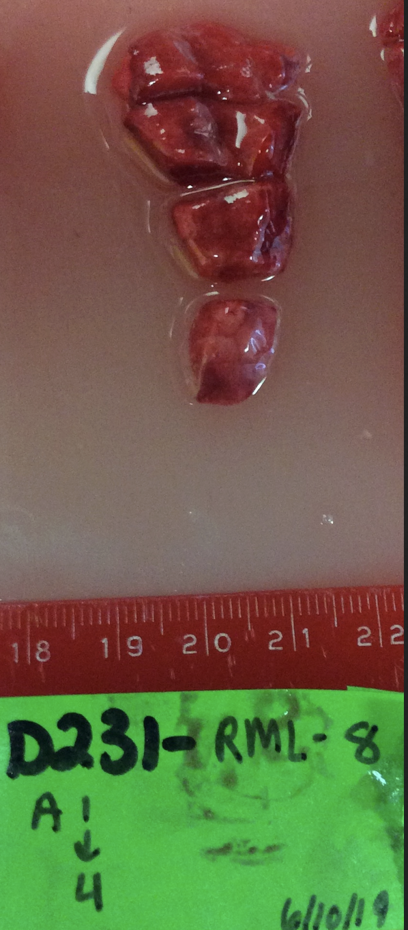
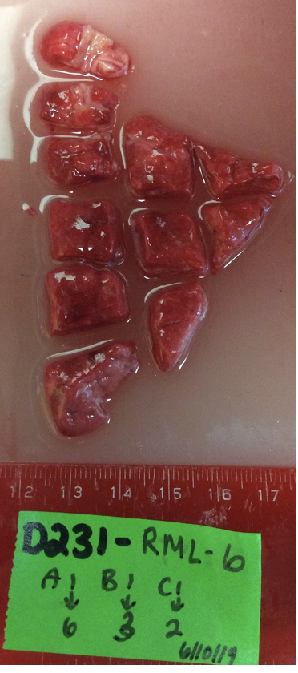
1
2
3
4
5
6
7
8
9
10
11
12
13
14
13
Frozen MPLex
D231_RML_8A2
D231_RML_6C2

Slide 4
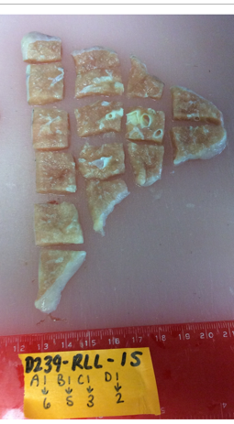
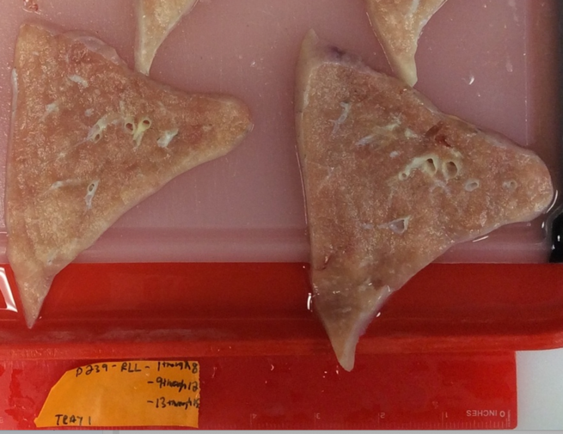
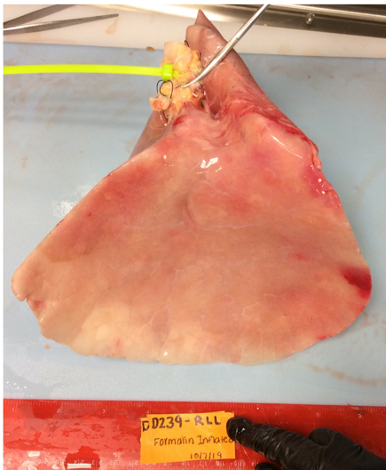
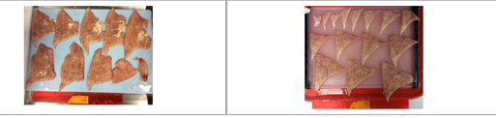
HBM554.FQRX.796 | D239-RLL-15B3 | TRUE | FALSE
1
2
3
4
5
6
7
8
9
10
11
12
13
14
15
16
17
18
19
20
21
22
23
24
25
26
27
28
29
25
D239-RLL

Slide 5
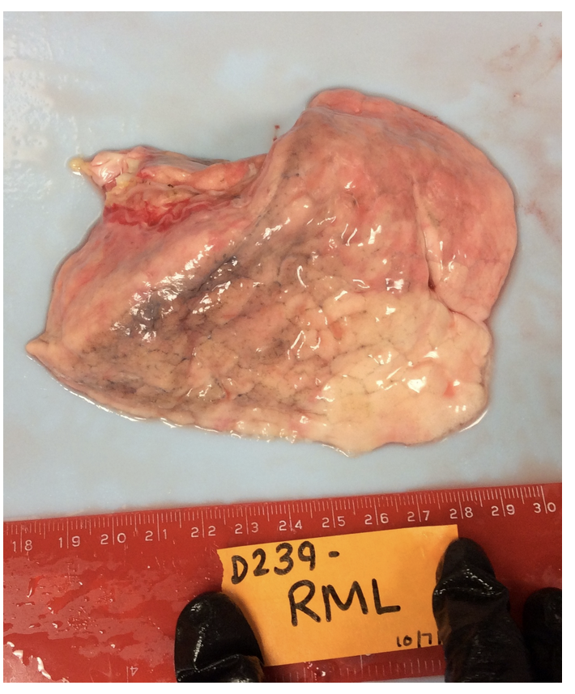
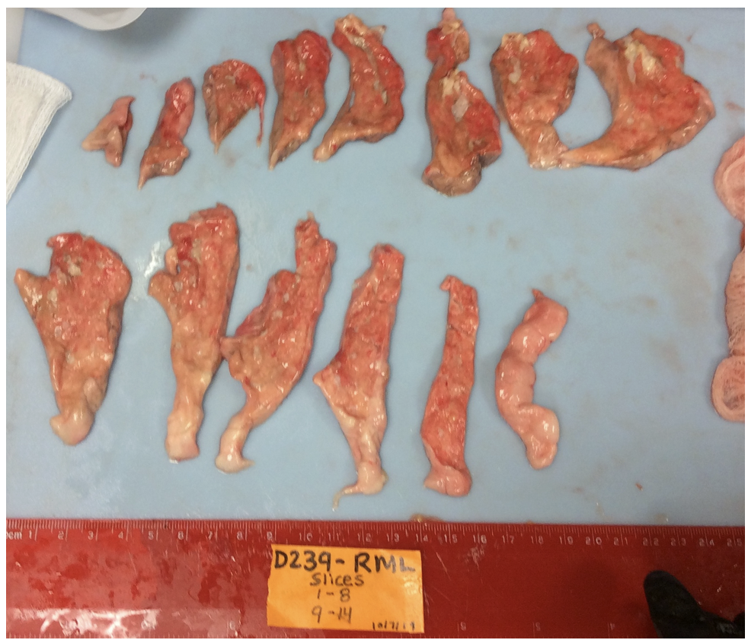
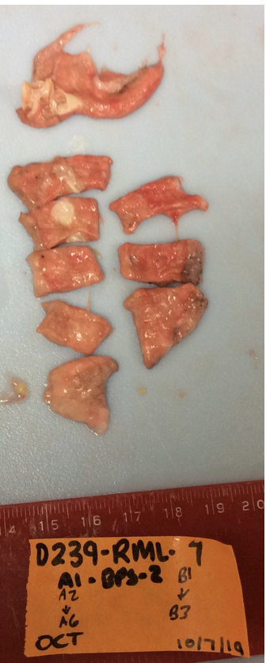
1
2
3
4
5
6
7
8
9
10
11
12
13
14
15
14
D239_RML_753
Frozen MPLex

Slide 6
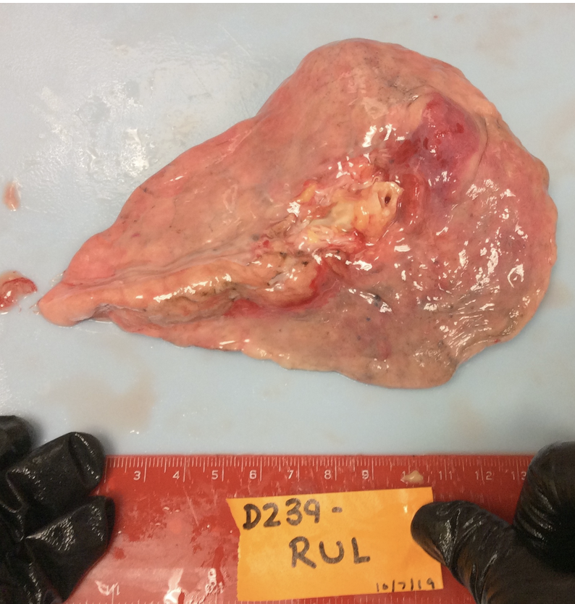
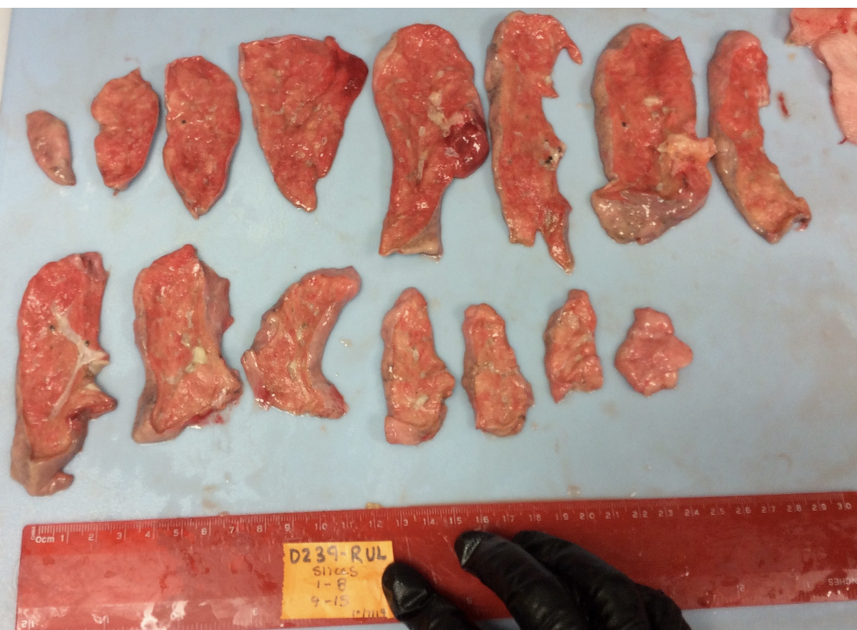
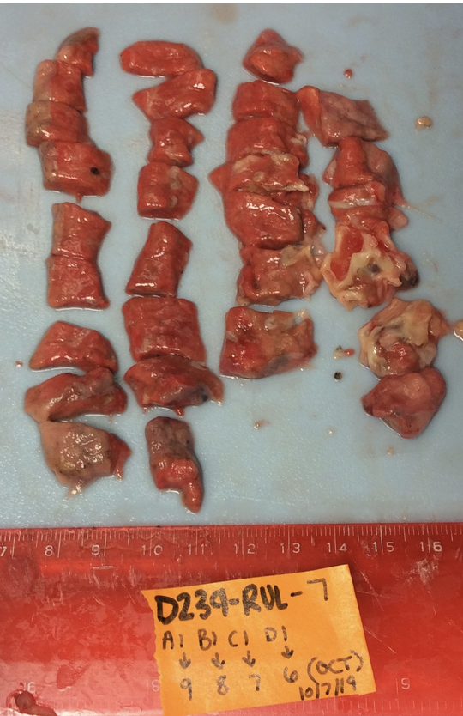
10
11
12
13
14
15
16
1
2
3
4
5
6
7
8
9
15
D239_RUL_7D5

Slide 7
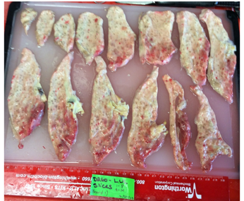
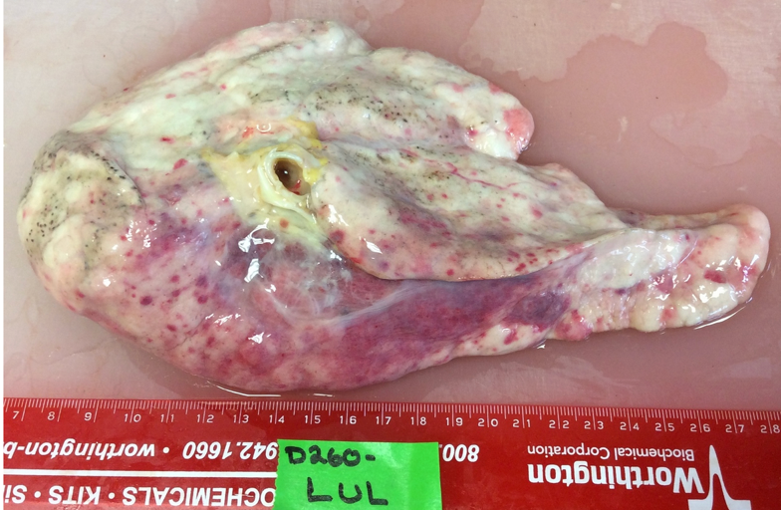
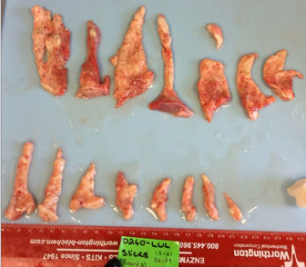
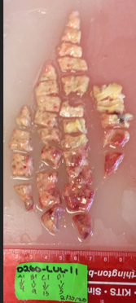
10
11
12
13
14
15
16
17
18
19
20
21
22
23
24
25
26
27
28
29
1
2
3
4
5
6
7
8
9
D260-LUL
HBM776.MWMG.262 | D260-LUL-11A3 | TRUE | FALSE

Slide 8
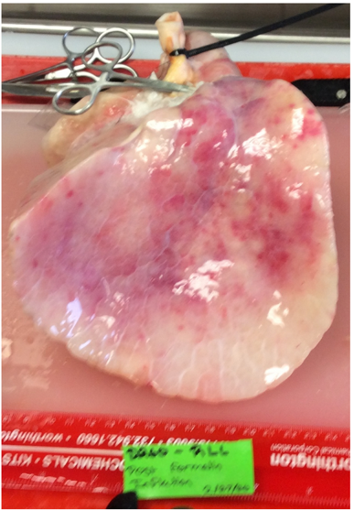
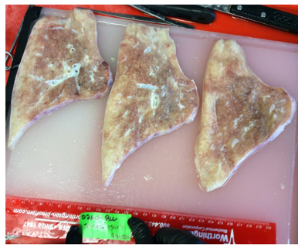
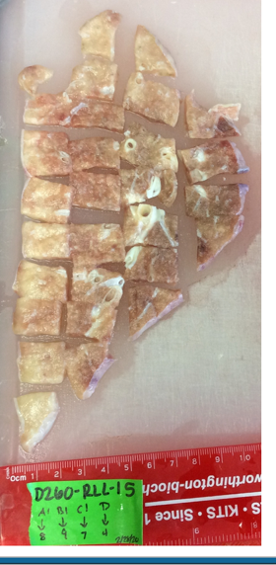
10
11
12
13
14
15
16
17
18
19
20
21
22
23
24
25
26
27
28
29
1
2
3
4
5
6
7
8
9
D260-RLL-15C3
D260-RLL

Slide 9
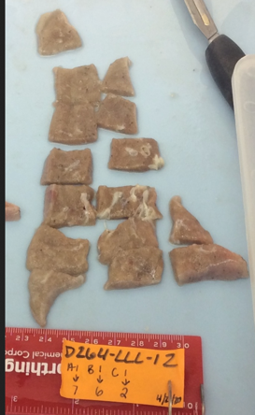
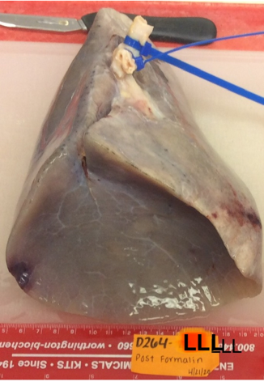
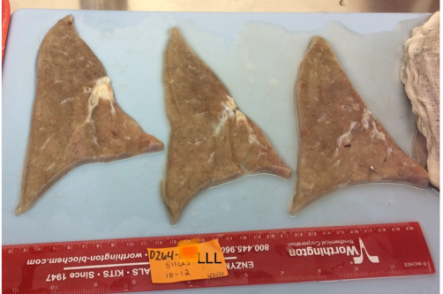
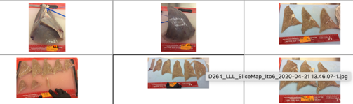
HBM548.KWTN.354 | D264-LLL-12B3 | TRUE | FALSE
1
2
3
4
5
6
7
8
9
10
11
12
13
14
15
16
17
18
19
20
21
22
23
24
25
26
27
28
29
20
D264-LLL
20

Slide 10
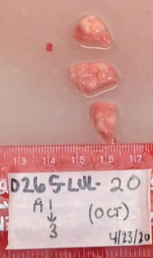
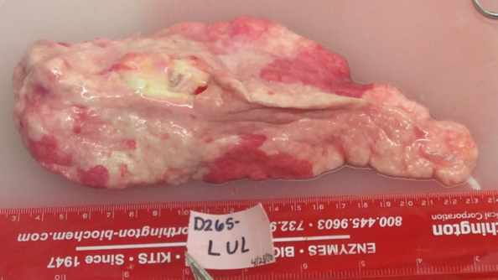
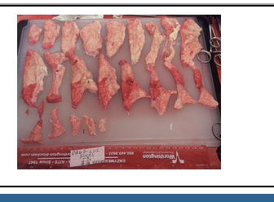
D265-LUL-20A2
10
11
12
13
14
15
16
17
18
19
20
21
22
23
24
25
26
27
28
29
1
2
3
4
5
6
7
8
9
D265-LUL

Slide 11
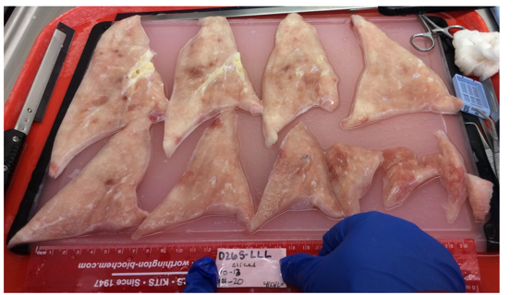
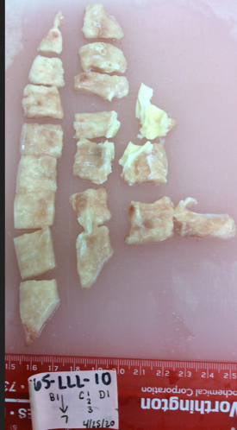
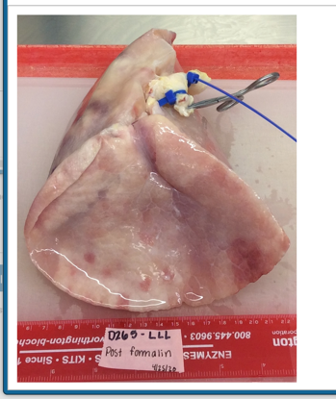
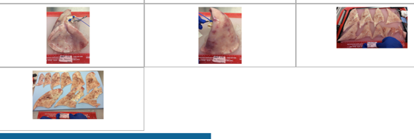
HBM745.XSZJ.387 | D265-LLL-10A7 | TRUE | FALSE
10
11
12
13
14
15
16
17
18
19
20
21
22
23
24
25
26
27
28
29
1
2
3
4
5
6
7
8
9
Left Lateral Basal
D265-LLL

Slide 12
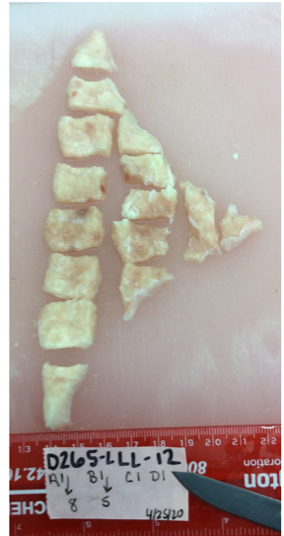
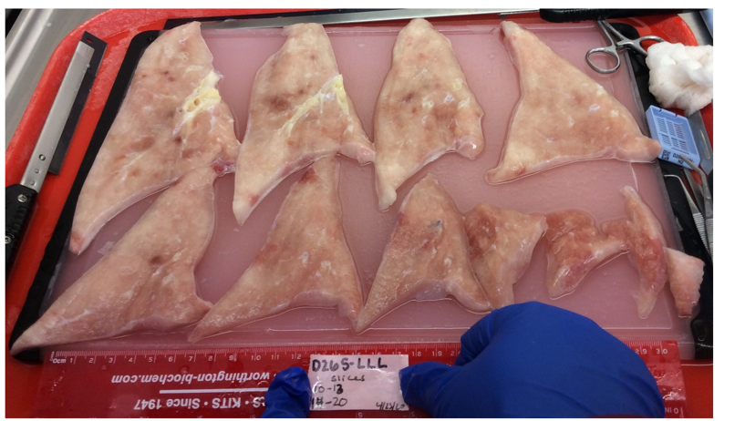
HBM727.WZMV.684 | D265-LLL-12B2 | TRUE | FALSE
??)
Left superior
D265-LLL

Slide 13
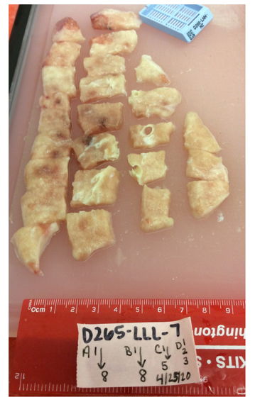
HBM879.PRLJ.697 | D265-LLL-7A7 | TRUE | FALSE
??
D265-LLL

Slide 14
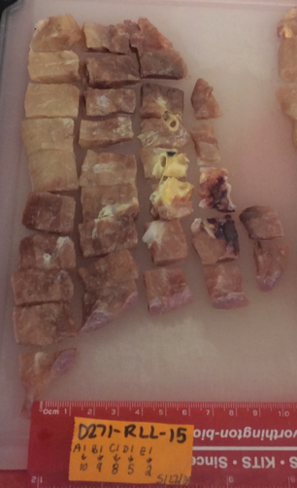
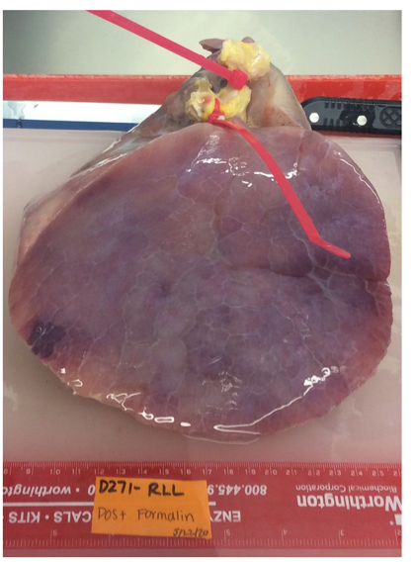
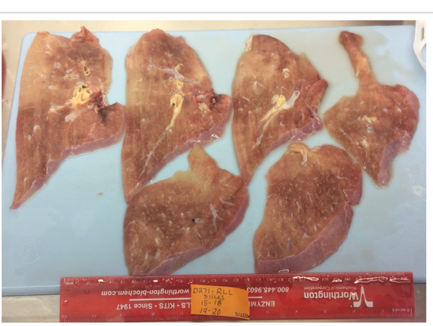
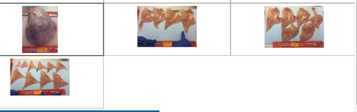
HBM395.JPSZ.677 | D271-RLL-15B7 | TRUE | FALSE
10
11
12
13
14
15
16
17
18
19
20
21
22
23
24
25
26
27
28
29
1
2
3
4
5
6
7
8
9
D271-RLL

Slide 15
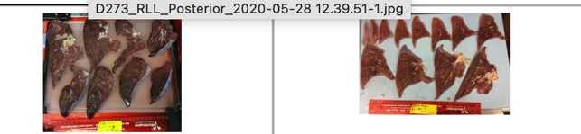
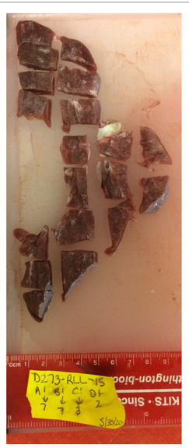
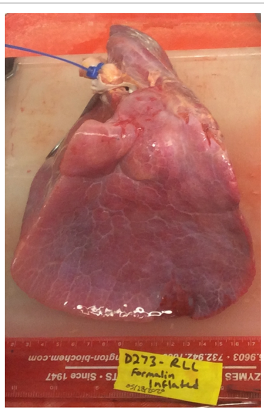
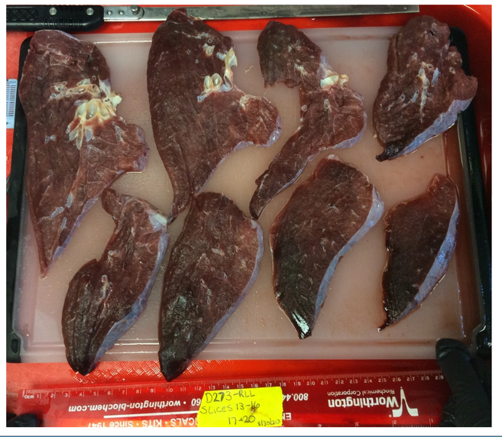
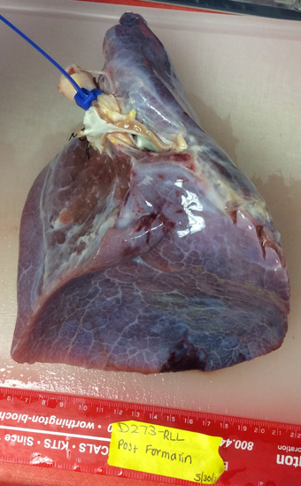
HBM795.MJCN.964 | D273-RLL-15B3 | TRUE | FALSE
10
11
12
13
14
15
16
17
18
19
20
21
22
23
24
25
26
27
28
29
1
2
3
4
5
6
7
8
9
D273-RLL

Slide 16
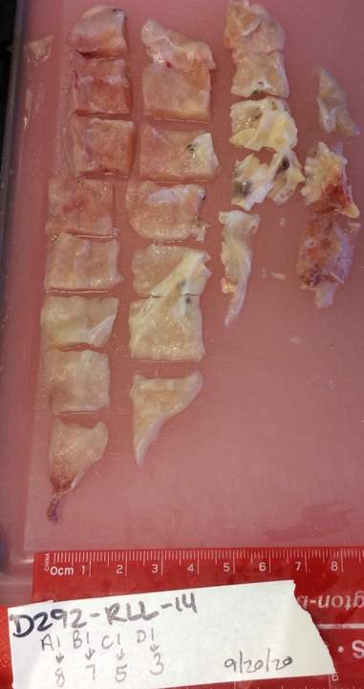




HBM536.PJNF.357 | D292-RLL-14C2 | TRUE | FALSE
10
11
12
13
14
15
16
17
18
19
20
21
22
23
24
25
26
27
28
29
1
2
3
4
5
6
7
8
9
D292-RLL

Slide 17




D292-RLL-19B4
D292-RLL

Slide 18




10
11
12
13
14
15
16
17
18
19
20
1
2
3
4
5
6
7
8
9
18
D292-RUL-5B6
D292-RUL-5B6
D292-RUL-8B5
Frozen MPLex

Slide 19




HBM967.CLZG.977 | D341-RLL-17C4 | TRUE | FALSE
10
11
12
13
14
15
16
17
18
19
20
21
22
23
24
25
26
27
28
29
1
2
3
4
5
6
7
8
9
D341-RLL

Slide 20


15
16
17
18
11
12
13
14
10
6
7
8
9
3
4
5
1
2
D341-RUL

Slide 21



10
11
12
13
14
15
16
17
1
2
3
4
5
6
7
8
9
16
D341-RUL-9A11
D341-RUL-9C3
Frozen MPLex

Slide 22


10
11
12
13
14
15
16
17
18
19
20
21
22
23
24
25
26
27
28
29
1
2
3
4
5
6
7
8
9
D342-RLL

Slide 23







HBM965.ZLXX.544 | D346-RLL-20B3 | TRUE | FALSE
10
11
12
13
14
15
16
17
18
19
20
21
22
23
24
25
26
27
28
29
1
2
3
4
5
6
7
8
9
D346-RLL

Slide 24



D346-RLL-21C5
10
11
12
13
14
15
16
17
18
19
20
21
22
23
24
25
26
27
28
29
1
2
3
4
5
6
7
8
9
D346-RLL

Slide 25


10
11
12
13
14
15
16
17
18
19
20
21
22
23
24
25
26
27
28
29
1
2
3
4
5
6
7
8
9
D346-RUL

Slide 26



10
11
12
13
14
15
16
17
18
19
20
1
2
3
4
5
6
7
8
9
17
D346-RUL-9A2
D346-RUL-9D1
Frozen MPLex

Slide 27





10
11
12
13
14
15
16
17
18
19
20
1
2
3
4
5
6
7
8
9
18
D373-RUL-6B5
D373-RUL-7B4
Frozen MPLex

Slide 28





HBM365.VQCJ.346 | D403-RLL-16A3 | TRUE | FALSE
HBM848.MCDW.627 | D403-RLL-15B3 | TRUE | FALSE
yes
10
11
12
13
14
15
16
17
18
19
20
21
22
23
24
25
26
27
28
29
1
2
3
4
5
6
7
8
9
D403-RLL

Slide 29




10
11
12
13
14
15
16
17
18
19
20
1
2
3
4
5
6
7
8
9
18
D403-RUL-8A6
D403-RUL-10A6
Frozen MPLex

Slide 30





10
11
12
13
14
15
16
17
18
19
20
21
1
2
3
4
5
6
7
8
9
21
D407-RUL-8A4
D407-RUL-11A3
Frozen MPLex

